Slide 1
Smoke Detection
By:
yokesh K

Slide 2
AGENDA
Problem Statement
FLOW OF THE PROJECT
Data collection
Preprocessing
First Data-Frame
Class Imbalance
Outliers
Second Data-Frame
Feature Selection
Third Data-Frame
DEMERITS

Slide 3
Problem Statement
To Develop a machine learning model that can accurately identify instances of smoke or non-smoke.
Predictor is categorical column so Predicted the best fitted model using classification machine learning algorithm.

Slide 4
FLOW OF THE PROJECT
Data Collection
Data Preprocessing
Data Frame 1
Class Imbalance
EDA
Feature selection
Data Frame 2
Data Frame 3

Slide 5
Data Collection
In the dataset there are 62630 Rows and 16 Columns.
It has columns consist of numerical and are categorical.
The target column is Categorical so, I perform Classification Machine learning Algorithm.

Slide 6
Data Frame 1
MODEL | ACCURACY | FPR | TPR | F1SCORE
LOG | 98.882325 | 0.013414 | 0.994413 | 0.980716
Dt | 100.000000 | 0.000000 | 1.000000 | 1.000000
RF | 100.000000 | 0.000000 | 1.000000 | 0.999022
SVC | 98.052052 | 0.000335 | 0.998883 | 0.999022
KNN | 99.944116 | 0.022803 | 0.988827 | 0.961957
Adaboost | 100.000000 | 0.000000 | 1.000000 | 1.000000
XGBoost | 99.992017 | 0.000000 | 0.999721 | 0.999860

Slide 7

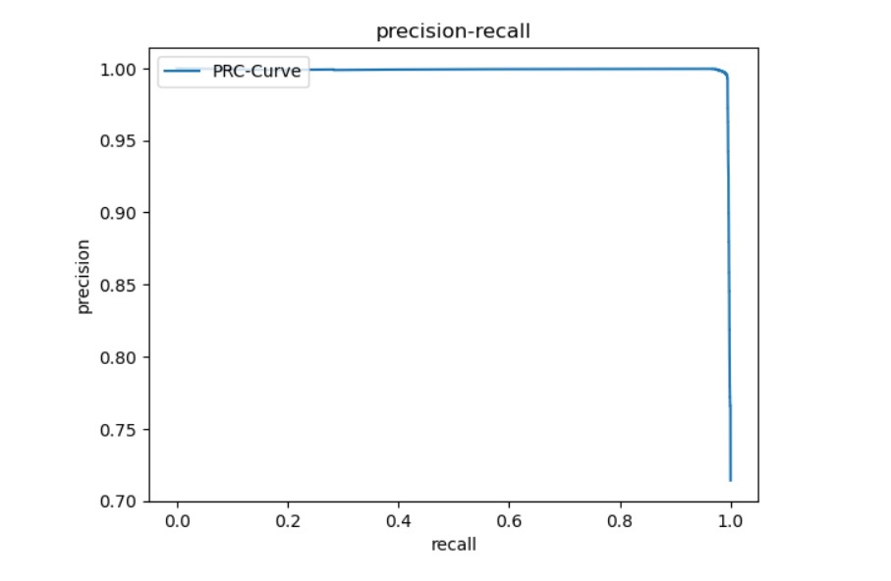
Conclusion for Data frame 1
Logistic Regression model achieved the highest accuracy at 98.882325 and also had a relatively low false positive rate(fpr) of 0.013414 and true positive rate 0.994413 and f1 score 0.980716 also high.

Slide 8
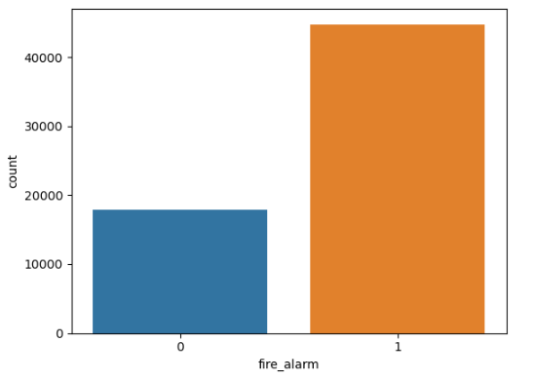
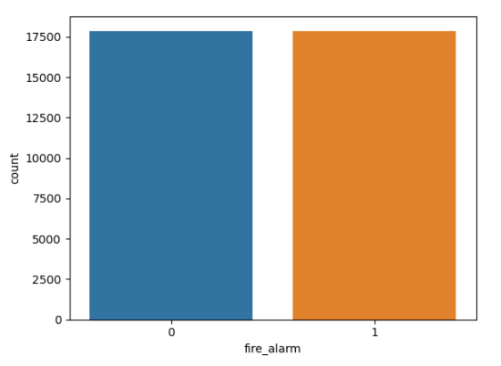
Class Imbalance
I perform under sampling technique these are before and after the class imbalance of Target Variable.
Before
After

Slide 9
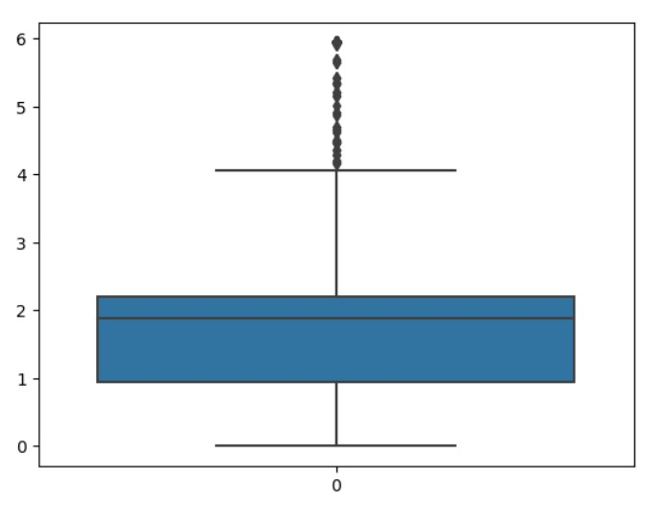
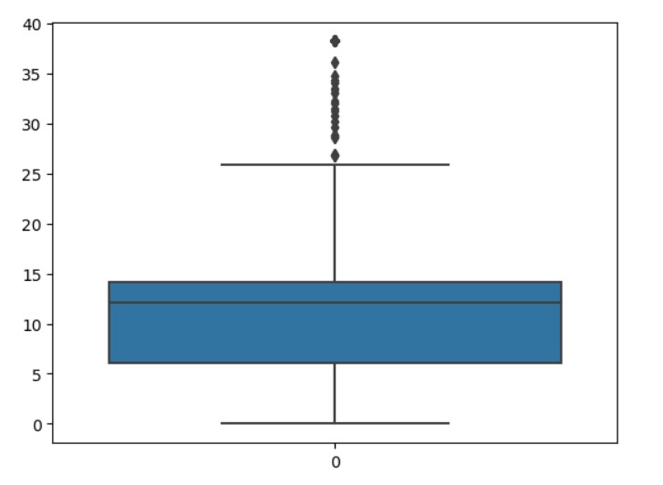
OUTLIER
Box Plot For Outlier in data
nc1_0
nc0_5

Slide 10
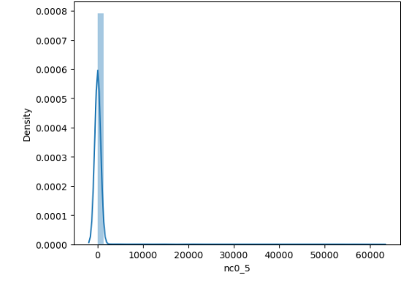
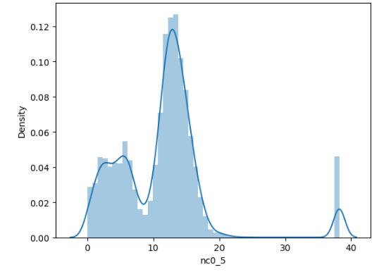
SKEWNESS
nc0_5
nc0_5
Before
After

Slide 11
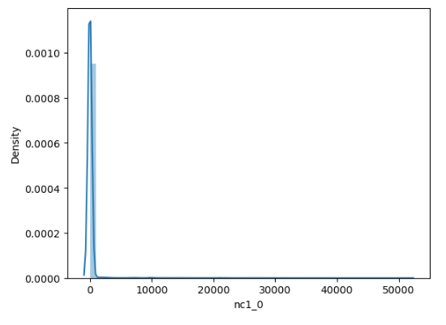
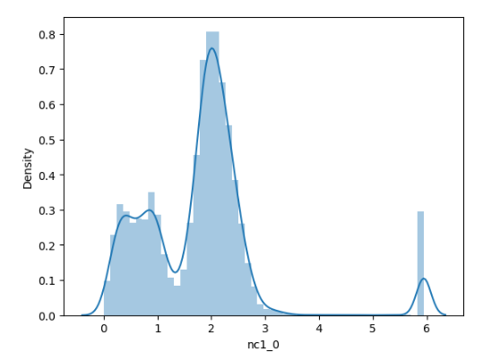
SKEWNESS
nc1_0
nc1_0
Before
After

Slide 12
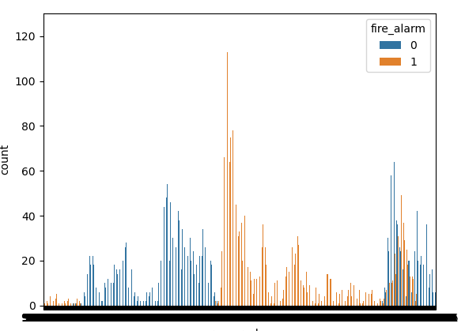
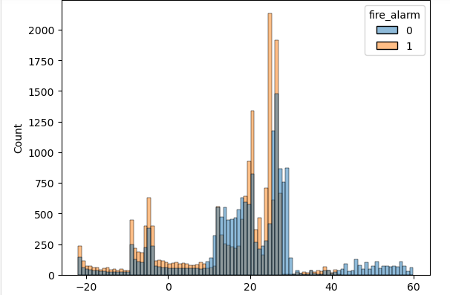
visualization
Pressure_hpa
Temperature

Slide 13
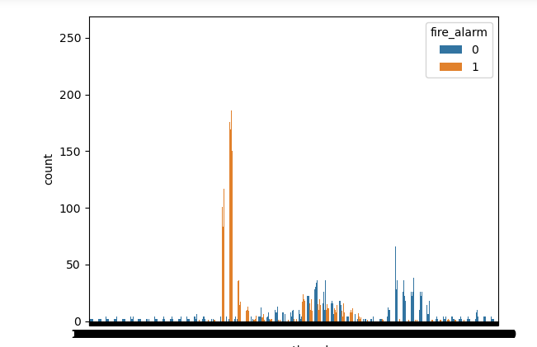
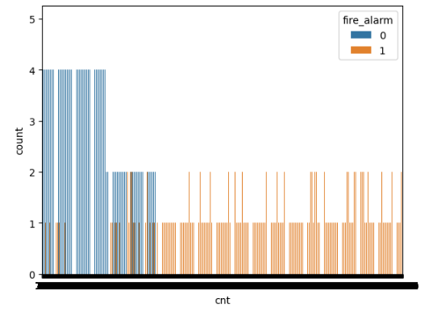
visualization
Raw_ethanol
Cnt

Slide 14
Data Frame 2
MODEL | ACCURACY | FPR | TPR | F1SCORE
LOG | 98.713287 | 0.025684 | 0.999150 | 0.986570
Dt | 99.958042 | 0.000276 | 1.000000 | 0.999858
RF | 99.986014 | 0.000000 | 1.000000 | 1.000000
SVC | 97.356643 | 0.055786 | 0.999433 | 0.934305
KNN | 99.958042 | 0.000552 | 1.000000 | 0.999717
Ada boost | 99.972028 | 0.000276 | 1.000000 | 0.999858
XG boost | 99.986014 | 0.000000 | 1.000000 | 1.000000

Slide 15
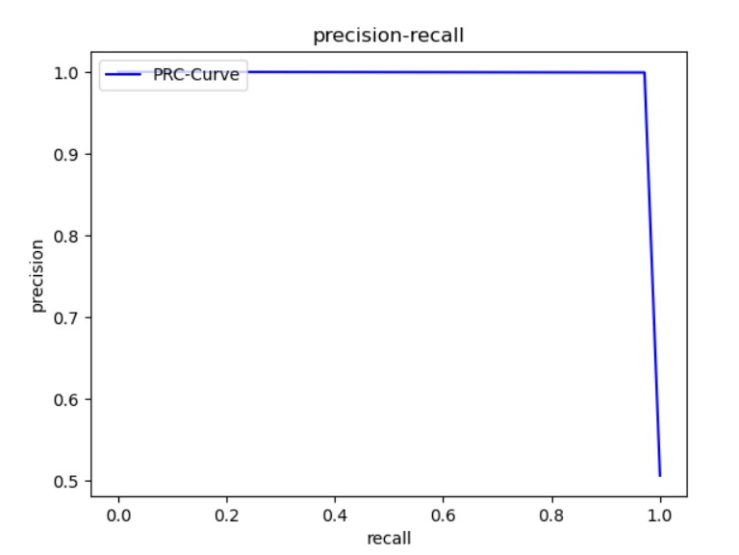
Conclusion for Data frame 1
Logistic Regression model achieved the highest accuracy at 98.713287 and also had a relatively low false positive rate(fpr) of 0.025684 and true positive rate 0.999150 and f1 score 0.986570 also high.

Slide 16
Feature Engineering
Perform Recursive Feature Elimination
Dataset having 13 column in that only 6 column selected as a importance feature which are significant.

Slide 17
Data Frame 3
 | Model Name | accuracy | fpr | tpr | f1score
 | log | 96.573427 | 0.044463 | 0.978181 | 0.966676
 | dt | 99.986014 | 0.000276 | 1.000000 | 0.999858
 | rf | 99.986014 | 0.000000 | 1.000000 | 1.000000
 | svc | 92.461538 | 0.129246 | 0.973080 | 0.924236
 | knn | 99.384615 | 0.008561 | 0.995466 | 0.993355
 | adaboost | 99.986014 | 0.000276 | 1.000000 | 0.999858
 | xgboost | 99.986014 | 0.000000 | 1.000000 | 1.000000

Slide 18
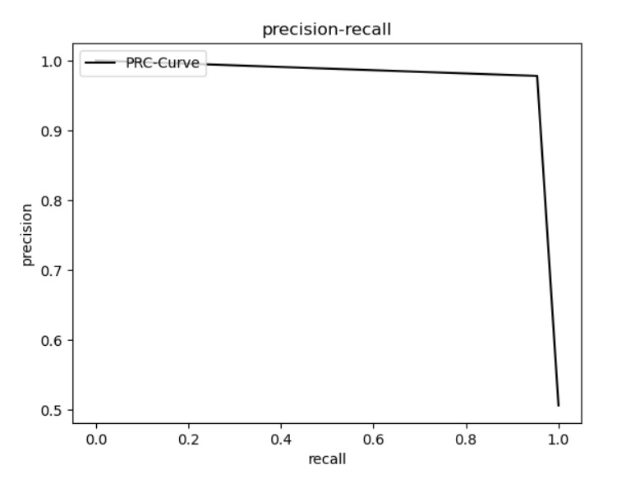
Third PRC
Logistic Regression model achieved the highest accuracy at 96.573427 and also had a relatively low false positive rate(fpr) of 0.044463 and true positive rate 0.978181 and f1 score 0.966676 also high.

Slide 19
DEMERITS OF SMOKE DETECTION
Data Dependence: Machine learning models require large amounts of labeled data for training, which can be difficult to obtain for rare events like smoke detection, leading to potential bias or inadequate model performance.
Generalization Issues: Models may struggle to generalize well to unseen environments or types of smoke, leading to false alarms or missed detections.
Maintenance and Adaptation: Models may require frequent updates and maintenance to adapt to changing environments, smoke characteristics, or hardware configurations.

Slide 20
THANK YOU

